Slide 1
3D Transformations
CPI 411 Graphics for Games

Slide 2
Agenda
3D Translation
3D Rotation
3D Scaling
3D Reflection
3D Shear

Slide 3
3D Transformations
all concepts can be extended to 3D in a straight forward way
+ projections 3D → 2D

Slide 4
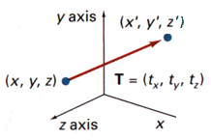
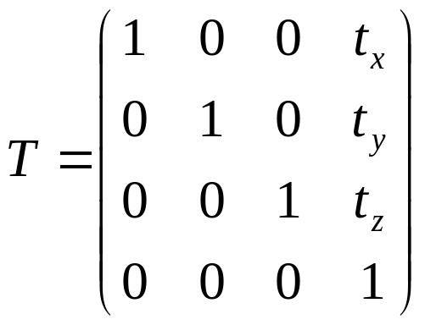
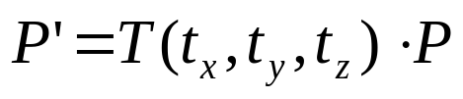
3D Translation
demo

Slide 5
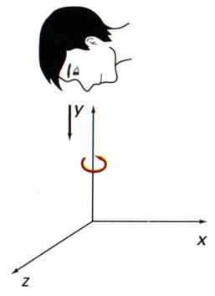
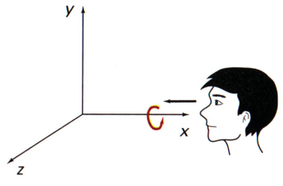
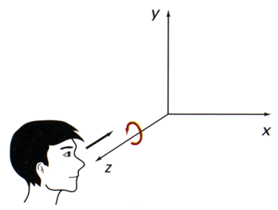
3D Rotation: Angle Orientation
rotation axis
positive angle ⇒ ccw rotation

Slide 6
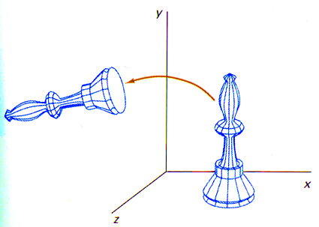
3D Rotation: Coord. Axes (z-axis)
⎡
x
′
⎤
⎡
cos
θ
−
sin
θ
0
0
⎤
⎡
x
⎤
⎢
′
⎥
⎢
⎥
⎢
⎥
y
sin
θ
cos
θ
0
0
y
⎢
⎥
=
⎢
⎥
⋅
⎢
⎥
⎢
z
′
⎥
⎢
0
0
1
0
⎥
⎢
z
⎥
⎢
⎥
⎢
⎥
⎢
⎥
⎣
1
⎦
⎣
0
0
0
1
⎦
⎣
1
⎦
P
′
=
R
(
θ
)
⋅
P
z

Slide 7
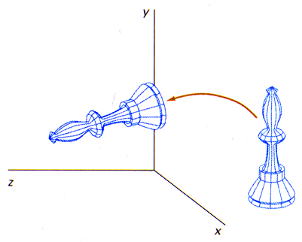
3D Rotation: Coord. Axes (x-axis)
⎡
x
′
⎤
⎡
1
0
0
0
⎤
⎡
x
⎤
⎢
′
⎥
⎢
−
⎥
⎢
⎥
y
0
cos
θ
sin
θ
0
y
⎢
⎥
=
⎢
⎥
⋅
⎢
⎥
⎢
z
′
⎥
⎢
0
sin
θ
cos
θ
0
⎥
⎢
z
⎥
⎢
⎥
⎢
⎥
⎢
⎥
⎣
1
⎦
⎣
0
0
0
1
⎦
⎣
1
⎦
P
′
=
R
(
θ
)
⋅
P
x

Slide 8
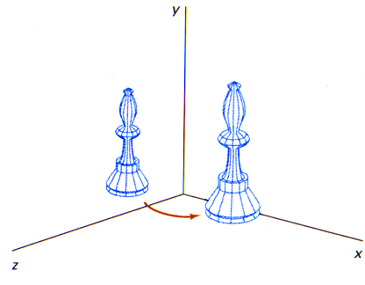
3D Rotation: Coord. Axes (y-axis)
⎡
x
′
⎤
⎡
cos
θ
0
sin
θ
0
⎤
⎡
x
⎤
⎢
′
⎥
⎢
⎥
⎢
⎥
y
0
1
0
0
y
⎢
⎥
=
⎢
⎥
⋅
⎢
⎥
⎢
z
′
⎥
⎢
−
sin
θ
0
cos
θ
0
⎥
⎢
z
⎥
⎢
⎥
⎢
⎥
⎢
⎥
⎣
1
⎦
⎣
0
0
0
1
⎦
⎣
1
⎦
P
′
=
R
(
θ
)
⋅
P
y

Slide 9
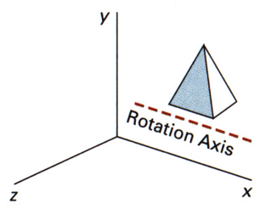
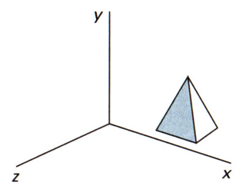
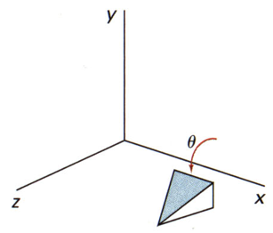
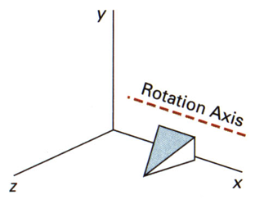
3D Rotation: Axis Parallel to x-Axis
original object position
1.translate rotation axis onto
x-axis: T
T
⋅
)
θ
(
R
x
⋅
1
−
T
3.translate rotation axis to original position:T⁻¹
=
2. rotate object through angle θ
)
θ
(
R
Peter Wonka

Slide 10
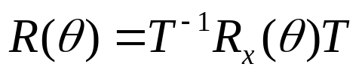
3D Rotation: Axis Parallel to x-Axis
translate rotation axis onto x-axis: T
rotate object through angle q
translate rotation axis to original position:T⁻¹

Slide 11
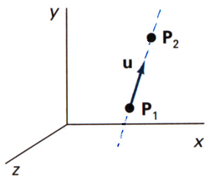
3D Rotation along Arbitrary Axis
an axis of rotation (dashed line) defined with points P₁ and P₂. The direction for the unit axis vector u is determined by the specified rotation direction
P
−
P
u
=
2
1
=
(
a
,
b
,
c
)
P
−
P
2
1

Slide 12
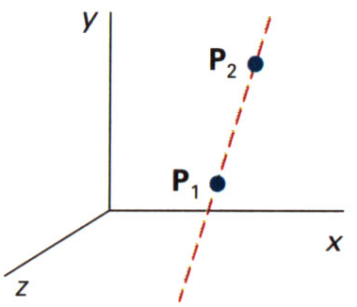
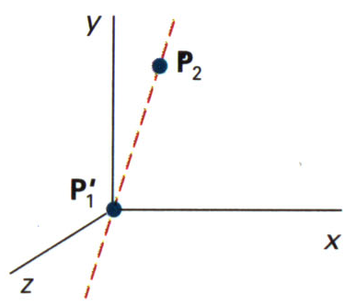
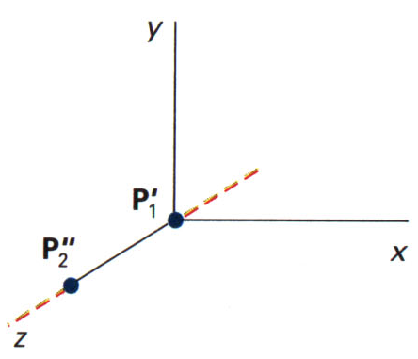
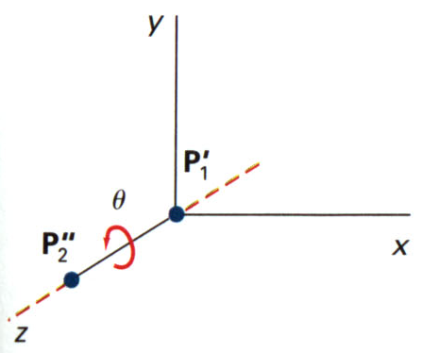
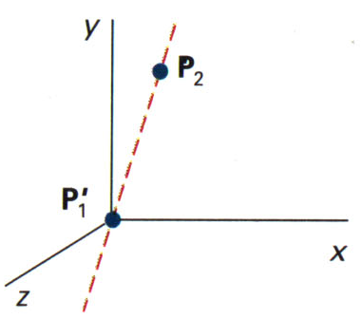
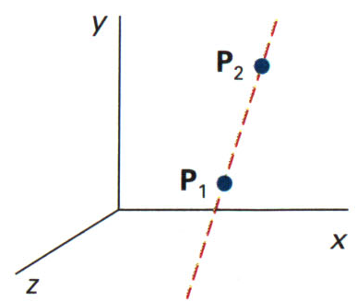
3D Rotation along Arbitrary Axis
initial position
1. translate P₁ to origin
2. rotate P₂’ onto z-axis
3. rotate object around z-axis
4. rotate axis to original orientation
5. translate axis to original position

Slide 13
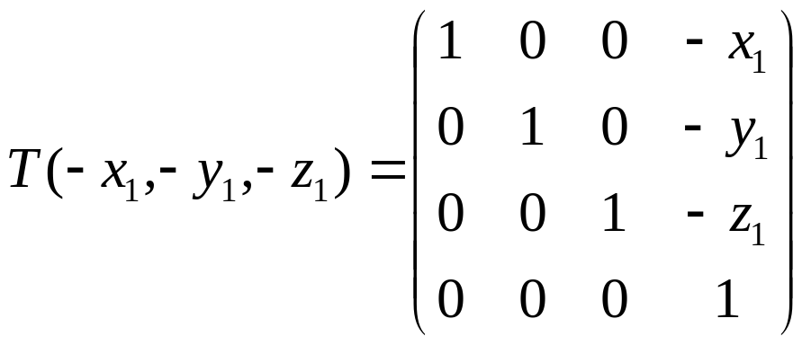
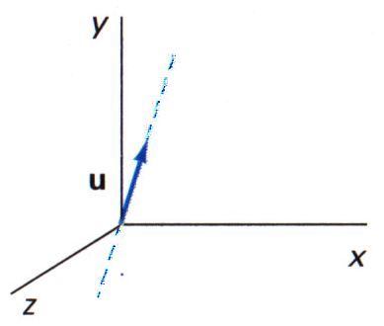
3D Rotation along Arbitrary Axis
step 1: translation T(-x₁,-y₁,-z₁)

Slide 14
3D Rotation along Arbitrary Axis
initial position
1. translate P₁ to origin
2. rotate P₂’ onto z-axis
3. rotate object around z-axis
4. rotate axis to original orientation
5. translate axis to original position

Slide 15
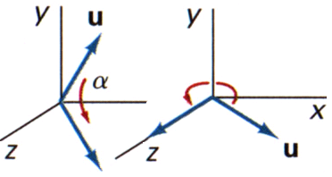
3D Rotation along Arbitrary Axis
Step 2: rotation so that u coincides with z-axis
  R_{x}(α): u → xz-plane
  R_{y}(β): u → z-axis
2a:
2b:
β
α

Slide 16
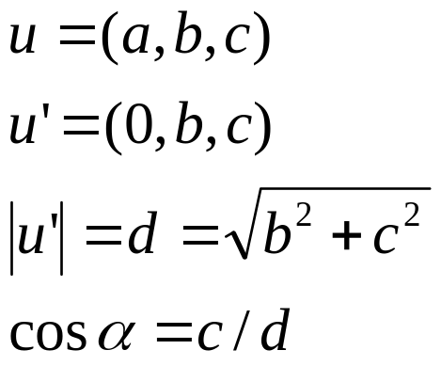
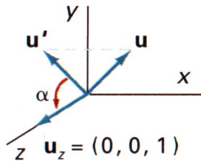
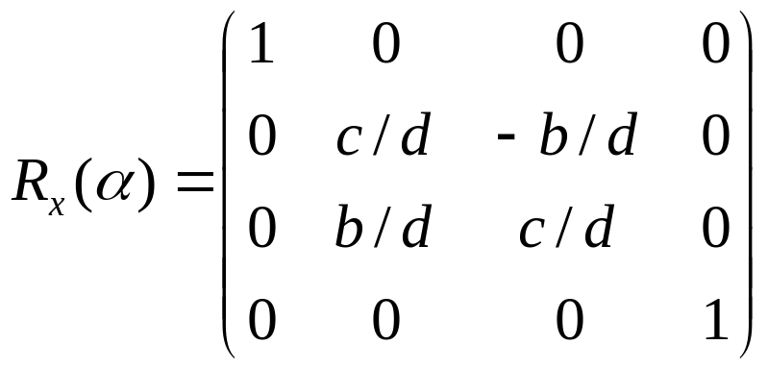
3D Rotation along Arbitrary Axis
Step 2a:
y
d
b
α
z
c
α

Slide 17
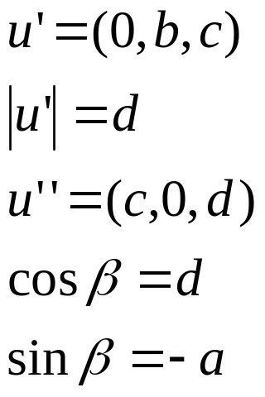
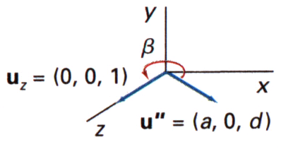
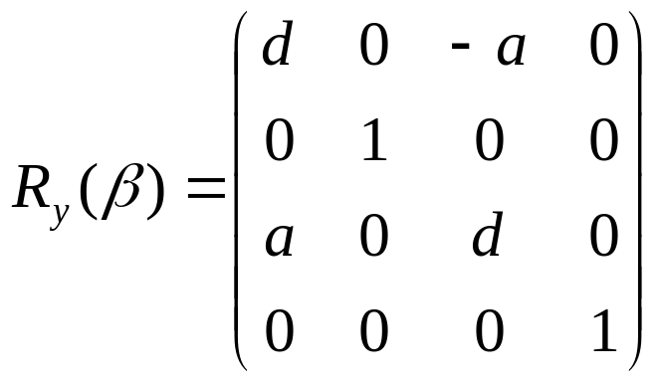
3D Rotation along Arbitrary Axis
x
β
Step 2b:
1
d
a
z

Slide 18
3D Rotation along Arbitrary Axis
initial position
1. translate P₁ to origin
2. rotate P₂’ onto z-axis
3. rotate object around z-axis
4. rotate axis to original orientation
5. translate axis to original position

Slide 19
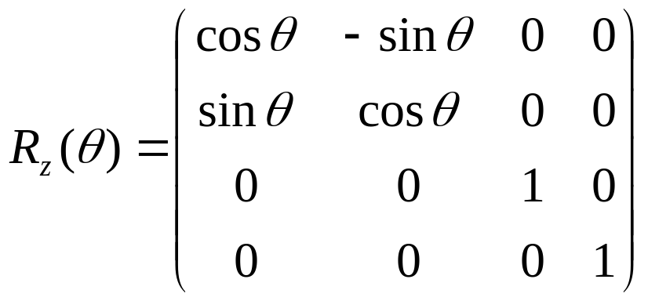
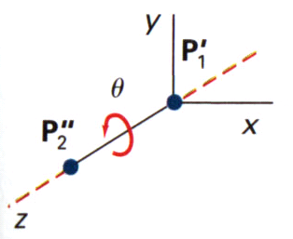
3D Rotation along Arbitrary Axis
step 3:
  u aligned with z-axis
  rotation around z-axis

Slide 20
3D Rotation along Arbitrary Axis
initial position
1. translate P₁ to origin
2. rotate P₂’ onto z-axis
3. rotate object around z-axis
4. rotate axis to original orientation
5. translate axis to original position

Slide 21
3D Rotation along Arbitrary Axis
Step 4: undo rotations of step 2
Step 5: undo rotations of step 2
Remember the inverse of rotation:
R
(
θ
)
=
T
−
1
⋅
R
−
1
(
α
)
⋅
R
−
1
(
β
)
⋅
R
(
θ
)
⋅
R
(
β
)
⋅
R
(
α
)
⋅
T
x
y
z
y
x
steps: 5 4a 4b 3 2b 2a 1
R
−
1
(
θ
)
=
R
(
−
θ
)
=
R
T
(
θ
)
x
x
x
demo

Slide 22
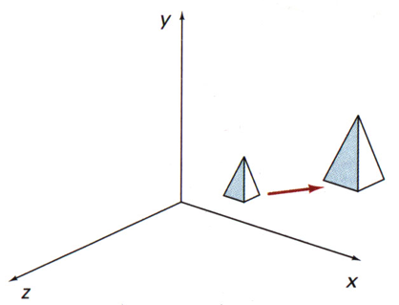
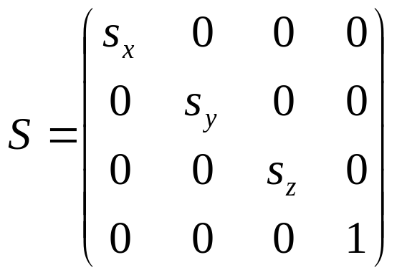
3D Scaling with respect to the Origin
Note: doubling the size of an object also moves the object farther from the origin
P
′
=
S
⋅
P

Slide 23
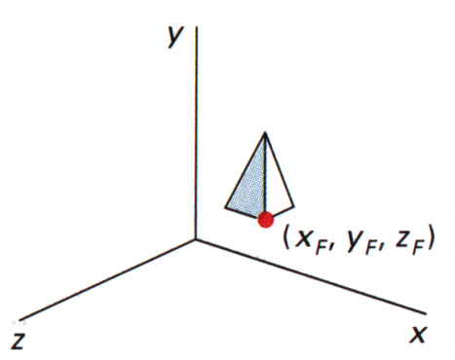
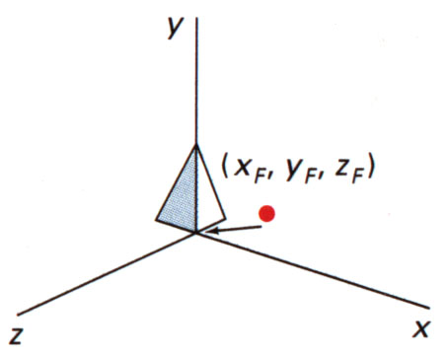
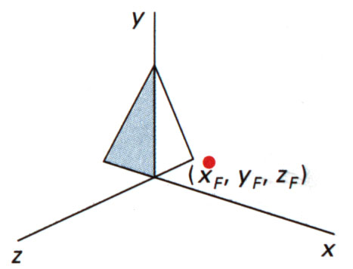
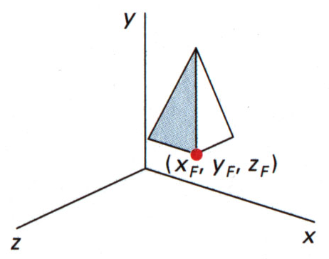
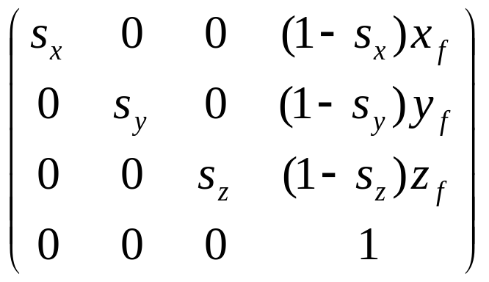
3D Scaling with general Fixed Point
T
(
x
,
y
,
z
)
⋅
S
(
s
,
s
,
s
)
⋅
T
(
−
x
,
−
y
,
−
z
)
f
f
f
x
y
z
f
f
f
demo

Slide 24
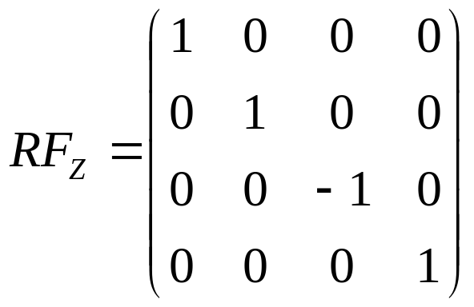
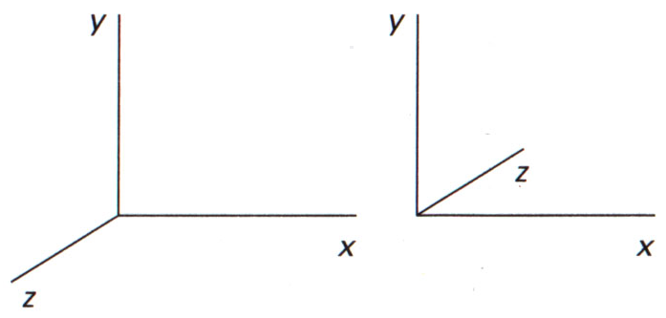
3D Reflection
reflection with respect to the xy-plane: RF_{z}
P'(a,b,-c)
P(a,b,c)
demo

Slide 25
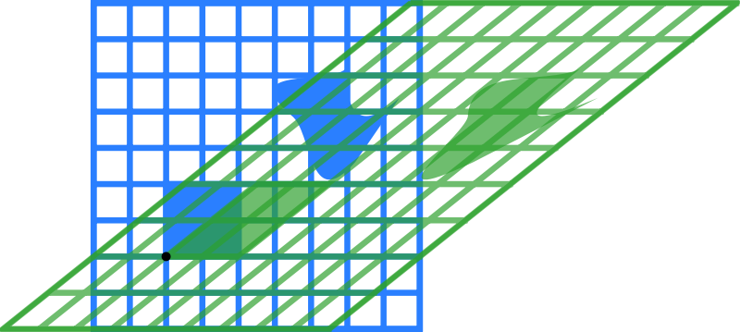
2D Shear
Black dot marks origin, m = 1.25 horizontal shear

Slide 26
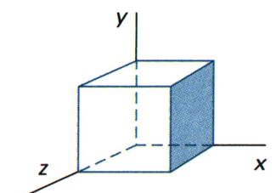
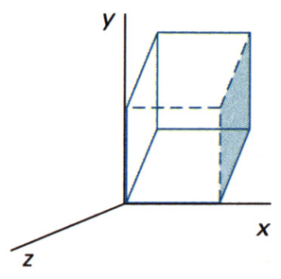
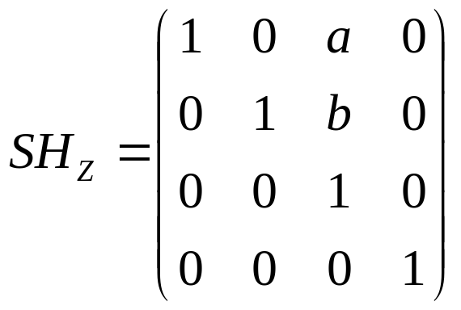
3D Shear
Example: shear relative to z-axis with a=b=1: SH_{Z}
b
a
demo

Slide 27
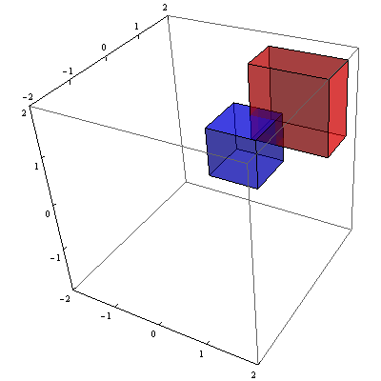
3D Rescaling
Scale the object to new fixed intervals, [xmin, xmax], [ymin, ymax], [zmin, zmax]
demo

